Slide 1


JavaServer Faces
Web Framework
www.supinfo.com
Copyright © SUPINFO. All rights reserved
Notes:
© SUPINFO International University - http://www.supinfo.com
SUPINFO vous permet de partager ce document
Vous êtes libre de :
Partager — reproduire, distribuer et communiquer ce document Remixer — modifier ce document
A condition de respecter les règles suivantes :
Indication obligatoire de la paternité — Vous devez obligatoirement préciser l’origine « SUPINFO » du document au début de celui-ci de la même manière qu’indiqué par SUPINFO International University – Notamment en laissant obligatoirement la première et la dernière page du document, mais pas d'une manière qui suggérerait que SUPINFO International University vous soutiennent ou approuvent votre utilisation du document, surtout si vous le modifiez. Dans ce dernier cas, il vous faudra obligatoirement supprimer le texte « SUPINFO Official Document » en tête de page et préciser notamment la page indiquant votre identité et les modifications principales apportées.
En dehors de ces dispositions, aucune autre modification de la première et de la dernière page du document n’est autorisée.
NOTE IMPORTANTE : Ce document est mis à disposition selon le contrat CC-BY-NC-SA Creative Commons disponible en ligne http://creativecommons.org/licenses ou par courrier postal à Creative Commons, 171 Second Street, Suite 300, San Francisco, California 94105, USA modifié en ce sens que la première et la dernière page du document ne peuvent être supprimées en cas de reproduction, distribution, communication ou modification. Vous pouvez donc reproduire, remixer, arranger et adapter ce document à des fins non commerciales tant que vous respectez les règles de paternité et que les nouveaux documents sont protégés selon des termes identiques. Les autorisations au-delà du champ de cette licence peuvent être obtenues à support@supinfo.com.
© SUPINFO International University – EDUCINVEST - Rue Ducale, 29 - 1000 Brussels Belgium . www.supinfo.com

Slide 2


Course objectives
JSF
By completing this course, you will be able to:
Explain how JSF works
Create ManagedBean
Develop web application with it
Use JSF components
Use Facelets as template engine

Slide 3


Preview
JSF
These are the parts that we will approach :
Introduction
Hello JavaServer Faces !
ManagedBeans
Components
Facelets syntaxe
Navigation concepts
DataModel
Templating
JSF Lifecycle
Converter
Validation
Composite Components

Slide 4
Introduction
JSF
What is JSF ?

Slide 5


Introduction
What it is ?
Server side component framework for building Java technology-based web applications
Provides a well-defined programming model and various tag libraries
One specification
JSR 314 (JSF 2.0)
Severals implementations :
Mojarra (Reference Implementation)
Apache MyFaces Project
Supported by the most important companies and organizations : IBM, Oracle, Apache, …

Slide 6
Introduction
Features
With JSF, you can with minimal efforts :
Create a web page
Drop components onto a web page by adding component tags
Bind component on a page to server-side data
Wire component-generated events to server-side application code
Save and restore application state beyond the life of server requests
Reuse and extend component through customization

Slide 7



Introduction
Architecture
Based on the Model View Controller (MVC) architecture for separating logic from presentation :
View
(XHTML Files)
Controller
(Managed Beans)
Model
(Data Store)

Slide 8
Introduction
Architecture
Layered directly on top of the Servlet API :
JavaServer Faces
JavaServer Pages
Standard Tag Library
JavaServer Pages
Java Servlet

Slide 9



Stop-and-think
Introduction
Do you have any questions ?
???

Slide 10
Hello JavaServer Faces !
JSF
A simple JavaServer Faces application

Slide 11
Hello JavaServer Faces !
First thing…
A JSF application is just like all Java web applications you developed
But using the JSF library
So the first thing you have to do to use JSF in your project is to :
Choose a JSF implementation
Download the corresponding libraries
Tips: NetBeans can do that for you

Slide 12
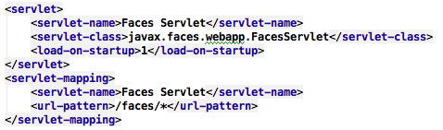
Hello JavaServer Faces !
Faces Servlet
To use JSF on top of the Servlet API, you have to declare a special Servlet provided by the Framework :
With this declaration, all the requests corresponding to the URL pattern will be handled by JSF

Slide 13
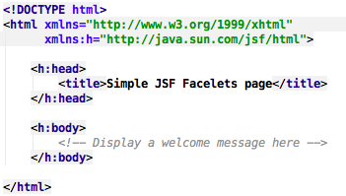
Hello JavaServer Faces !
View
We want a simple page displaying a welcome message with the current hour
First, we create a page hello.xhtml :
But… what are those strange tags ?

Slide 14
Hello JavaServer Faces !
View
JSF 2.0 use a template engine called Facelets instead of classical JSP pages
But you can still use them if you want…
What you need to understand for now about Facelets:
The namespace with the h prefix is a JSF taglib
The elements with that prefix are JSF components
We’ll come back more in details about Facelets later…

Slide 15
Hello JavaServer Faces !
Controller
Now, we need a component (controller ?) with which our view could ask the welcome message
This kind of component is called Managed Bean
Managed Bean are components that are managed by JavaServer Faces technology
Components in a page can be associated with them
Provide Application Logic

Slide 16
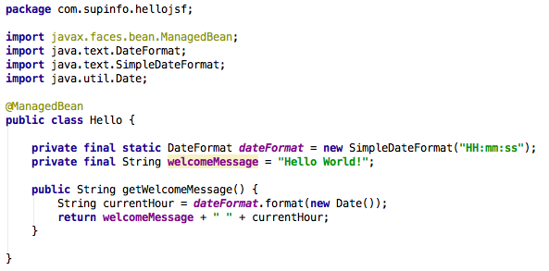
Hello JavaServer Faces !
Controller
For our application, we just need a simple Managed Bean as follow:

Slide 17
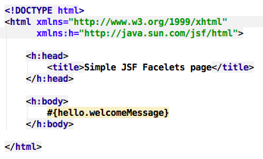
Hello JavaServer Faces !
View/Controller Interaction
To get this message from our view, we just need to use an Expression Language :
Be careful: JSF EL are prefixed by a # and not a $ !

Slide 18
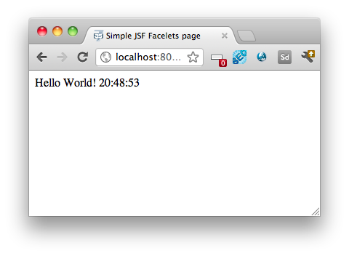
Hello JavaServer Faces !
Deploy it!
If we deploy our application and go to the following URL :
http://localhost:8080/faces/hello.xhtml
Notes:
Remember the URL pattern previously declared ! If you don’t use it, the page will be directly return to the client without execute the EL.

Slide 19
Stop-and-think
Hello JavaServer Faces !
Do you have any questions ?
???

Slide 20


Exercise
Hello JavaServer Faces !
HelloJSF is available on GitHub:
https://github.com/bargenson/HelloJSF
Clone or download the project
Try to deploy it on your Glassfish !

Slide 21
ManagedBeans
JSF
Or backing beans

Slide 22
What are ManagedBeans ?
ManagedBeans
ManagedBeans are JavaBeans
They are the link between Java objects and web pages
To use a JavaBean inside your web pages
Declare it as a ManagedBean:
Inside the faces-config.xml file
With the annotation @ManagedBean
Use it in your JSP or Facelets pages thanks to UEL
MyJavaBean
MyPage.jsp
faces-config.xml
<managed-bean>
...
</managed-bean>
Notes:
ManagedBean and UEL willexplainedfurther

Slide 23

How to declare them ?
ManagedBeans
In the faces-config.xml:
<?xml version='1.0' encoding='UTF-8'?>
<faces-config>
<managed-bean>
<managed-bean-name>beanName</managed-bean-name>
<managed-bean-class>
fully qualified class name
</managed-bean-class>
<managed-bean-scope>
(application|session|request|view|none)
</managed-bean-scope>
</managed-bean>
</faces-config>

Slide 24
How to declare them ?
ManagedBeans
A simple JavaBean …
… declared as a ManagedBean
public class User {
private String name;
// Getters and Setters
}
<managed-bean>
<managed-bean-name>user</managed-bean-name>
<managed-bean-class> com.supinfo.sun.jsf.model.User
</managed-bean-class>
<managed-bean-scope>session</managed-bean-scope>
</managed-bean>

Slide 25
How to declare them ?
ManagedBeans
With @ManagedBean annotation:
If the scope annotations are omitted, the bean must be handled as if the @RequestScoped annotation is present
@ManagedBean
(@ApplicationScoped|@SessionScoped|@RequestScoped|...)
public class User {
private String name;
// Getters and Setters
}
Notes:
The scope of the managed bean is declared using one of NoneScoped, RequestScoped, ViewScoped, SessionScoped, ApplicationScoped, or CustomScoped annotations

Slide 26
Initialize a ManagedBean
ManagedBeans
Initialize properties for a ManagedBean
Kind of default value
<managed-bean>
<managed-bean-name>user</managed-bean-name>
<managed-bean-class> com.supinfo.sun.jsf.model.User
</managed-bean-class>
<managed-bean-scope>
session
</managed-bean-scope>
<managed-property>
<property-name>name</property-name>
<value>Duke</value>
</managed-property>
</managed-bean>

Slide 27
Initialize a ManagedBean
ManagedBeans
Initialize properties for a ManagedBean with another ManagedBean :
<managed-bean>
<managed-bean-name>message</managed-bean-name>
<managed-bean-class>com.smtg.MessageBean</managed-bean-class>
<managed-bean-scope>session</managed-bean-scope>
</managed-bean>
<managed-bean>
<managed-bean-name>user</managed-bean-name>
<managed-bean-class>com.smtg.UserBean</managed-bean-class>
<managed-bean-scope>session</managed-bean-scope>
<managed-property>
<property-name>messageBean</property-name>
<property-class>com.smtg.MessageBean</property-class>
<value>#{message}</value>
</managed-property>
</managed-bean>

Slide 28
Initialize a ManagedBean
ManagedBeans
Or with @ManagedProperty annotation:
@ManagedBean @SessionScoped
public class HelloBean implements Serializable{
@ManagedProperty(name="#{message}")
private MessageBean messageBean;
// Various methods
}

Slide 29
Initialize a ManagedBean
ManagedBeans
Be careful while initializing a ManagedBean with another !
ManagedBean registered with scope … | … can only refer to other ManagedBeans with the following scopes
none | none
request | none, request, session, application
session | none, session, application
application | none, application

Slide 30
Use ManagedBeans
ManagedBeans
In your web pages
Link a simple value
Link a JSF component in a java class
<h:outputText value="#{bean.property}" />
<h:outputText binding="#{bean.component}" />
public class Bean {
private HtmlOutputText component;
// getter and setter
}

Slide 31
Unified Expression Language
ManagedBeans
UEL is a « language » with a special synthax
Interact with beans
Syntax: #{expression}
Accessing
Properties | #{person.name} #{person['name']}
Arrays, Lists | #{bean.tab[2]}
Maps | #{bean.map['key']}
Methods | #{bean.methodName}

Slide 32
Unified Expression Language
ManagedBeans
Java operators
instanceof
New operators:
Arithmetic: div et mod
Logic: and, or, not
Relational: ==, eq , !=, ne , <, lt , >, gt , <=, le ,>=, ge
These operators can compare primitives and String objects
empty : test if :
a value is null
or an array, or list is empty

Slide 33
Module Quiz introduction
ManagedBeans
What is the purpose of ManagedBeans?
Save values and process logic
How JSF tags access to Managed-Bean properties ?
Thank to Unified Expression Language, also called EL
How can we declare managed-beans ?
/WEB-INF/faces-config.xml
@ManagedBean
What scopes are available for a managed bean
application, session, request, view, none
Can I initialize some properties when a managed bean is instantiate ?
Yes

Slide 34
Stop-and-think
ManagedBeans
Do you have any questions ?
???

Slide 35
Components
JSF

Slide 36


Concept of JSF Components
Components
A component is made of
A class
A markup
All common components have these attributes
id: the identifier of the component
rendered: defines if the component is visible or not
public class UIComponent {
private int id;
public getId() { ... }
public void setId() { ... }
...
}
<h:baliseJSF id="identifier" />

Slide 37
Concept of JSF Components
Components
All the basic components are divide in two parts :
http://java.sun.com/jsf/core
Logic components
Example : converters, parameters, …
http://java.sun.com/jsf/html
Rendering HTML components
Example : form, fields, …

Slide 38








Common components
Components
inputText
commandButton
commandLink
dataTable
selectBooleanCheckbox
selectOneRadio
panelGrid
graphicImage
inputTextarea
inputSecret

Slide 39
Common components
Components
Declare a form:
Like HTML form
Don't have a method attribute
Post is used by default
<h:form>
<!-- Form fields -->
</h:form>
Notes:
Post is used by default but you can fire a PRG (Post-Redirect-Get) if you need to.

Slide 40
Common components
Components
Display a text
<h:outputText> and <h:outputLabel>
Attribute value defines the value to display
<p>
<h:outputText value="My Text" />
</p>
<h:outputLabel value="First Name:" for="firstName" />
<h:inputText id="firstName"
value="Your first name" />

Slide 41
Common components
Components
Text Fields
<h:inputText>, <h:inputTextarea>, <h:inputSecret> and <h:inputHidden>
Attribute value contains the current value of the component (can be an EL)
<div>
<h:inputText value="Default value" />
</div>
<!-- Rendered HTML -->
<div>
<input type="text" value="Default value" />
</div>

Slide 42
Common components
Components
Buttons
<h:commandButton>
Used for form validation
The action attribute allows to define navigation rules
We can also call a method from inside the attribute
<h:form>
<h:commandButton action="success" value="Send" />
</h:form>
<h:form>
<h:commandButton
action=”#{messageController.sendMessage}"
value="Send" />
</h:form>

Slide 43

Common components
Components
Links
<h:outputLink>
URL is defined by the value attribute
Text is defined by the text nested in
<h:commandLink>
Must be nested in a<h:form> tag
The action attribute is used by navigation.
<h:ouputLink value="contacts.xhtml">
<h:outputText value="Contacts" />
</h:ouputLink>
<h:form>
<h:commandLink action="outcome"
value="My link" />
</h:form>

Slide 44
Common components
Components
Check Box
<h:selectBooleanCheckbox>
Checkbox with only one choice
value attribute defines if the component is checked
<h:selectManyCheckbox>
Print a list of checkboxes
Declare items: <f:selectItem> or <f:selectItems>
value attribute is a collection where selected items will be stored
The value is a primitive, a Number or a String
<h:outputLabel for="choice" value="My text" />
<h:selectBooleanCheckbox id="choice”
value="#{bean.property}" />

Slide 45
Common components
Components
Radio button
<h:selectOneRadio>
Declaration is similar as <h:selectManyCheckbox>
value attribute stores the choice
<h:selectOneRadio value="#{bean.color}"
layout="lineDirection">
<f:selectItem itemValue="red" itemLabel="red" />
<f:selectItem itemValue="white" itemLabel="white" />
<f:selectItem itemValue="yellow" itemLabel="yellow" />
</h:selectOneRadio>

Slide 46
Common components
Components
Table
Static grid: <h:panelGrid> (you have to know its size)
<h:panelGrid border="1" columns="2">
<f:facet name="header">
<h:ouputText value="Header Text" />
</f:facet>
<f:facet name="footer">
<h:panelGroup>
<h:outputText value="Footer text" />
</h:panelGroup>
</f:facet>
<h:outputText value="A" />
<h:outputText value=“B" />
<h:outputText value=“C" />
<h:outputText value=“D" />
</h:panelGrid>

Slide 47
Common components
Components
Table
Dynamic table: <h:dataTable>
Useful for a Java arrays, Lists, ResultSets (used with JDBC)
<h:dataTable value="#{bean.dataModel}" var="line">
<h:column>
<f:facet name="header">
<h:ouputText value="Header text" />
</f:facet>
<h:outputText value="#{line.property}" />
</h:column>
<h:column>
<f:facet name="header">
<h:ouputText value="Header text 2" />
</f:facet>
<h:outputText value="#{line.property2}" />
</h:column>
</h:dataTable>

Slide 48
Customize rendering
Components
Customize HTML rendering
style attribute : CSS style
styleClass attibrute : CSS class
escape attribute : if true, '<', '>' and '&' are converted into HTML
JavaScript attributes:
onclick, ondblclick, onblur, onchange, onfocus, …
<h:outputText style="font-size: 150%; color: red"
value="Hello" />
JSF
HTML
<span style="font-size: 150%; color: red">Hello</span>

Slide 49
Passing parameters
Components
Pass a parameter: <f:param>
Retrieve parameters
Test if a parameter exist:
<h:outputLink value="index.jsp">
<h:outputText value="Index"/>
<f:param name="id" value="2"/>
<f:param name="sortBy" value="price"/>
</h:outputLink>
<h:outputText value="id=#{param.id}, sortBy=#{param.sortBy}"/>
#{!empty param.paramName}
Notes:
A ManagedBean param exists and allows us to retrieve parameters passed in a query

Slide 50
Module Quiz introduction
Components
Which tag allows to display text ?
<h:outputText>
What is the purpose of the « action » attribute ?
To return a navigation value
With JSF graphical component, is it possible to display a table ?
with <h:panelGrid> and <h:dataTable>.

Slide 51
Stop-and-think
Components
Do you have any questions ?
???

Slide 52
Navigation concept
JSF

Slide 53
Generalities on navigation
Navigation concept
JSF navigation is based on navigation rules
A navigation rule is indexed on message (String) called outcome
Navigation rules can be implicit or explicit
Explicit ones are declared in faces-config.xml thanks to <navigation-rules> markup
Implicit ones don’t need to be declared
For example
When you submit a form, the next page displayed is defined by a navigation rule

Slide 54
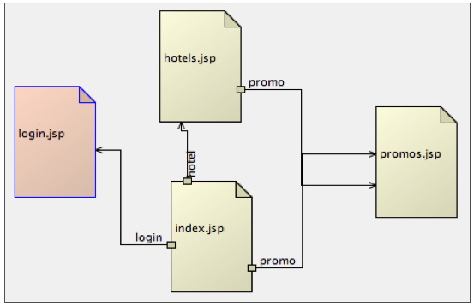
Explicit Declaration
Navigation concept
In faces-config.xml
A navigation rule can have many navigation cases…
...
<navigation-rule>
<from-view-id>/startPage.jsp</from-view-id>
<navigation-case>
<from-outcome>return_value</from-outcome>
<to-view-id>/destinationPage.jsp</to-view-id>
</navigation-case>
</navigation-rule>
...

Slide 55
Explicit Declaration - Example
Navigation concept
The return value is defined in the action attribute
It is available on some JSF tags
User is redirected to order.jsp
<h:form>
<h:commandLink action="success” value="Submit" />
</h:form>
...
<navigation-rule>
<from-view-id>/index.jsp</from-view-id>
<navigation-case>
<from-outcome>success</from-outcome>
<to-view-id>/order.jsp</to-view-id>
</navigation-case>
</navigation-rule>
...

Slide 56
Implicit navigation rules
Navigation concept
JSF 2 now supports implicit navigation
Don’t need to define a navigation rules inside JSF configuration file !
If an income isn’t declared, JSF will try to find and render a view with the outcome value as name
Example:
An undeclared outcome value “listProducts” will render (if exists) the listProducts.xhtml (or listProducts.jsp) page

Slide 57
Implicit navigation rules
Navigation concept
For example:
Submitting the following form :
… will try to render a view named page2.xhtml
<h:form>
<h:commandLink action="page2" value="Submit" />
</h:form>

Slide 58
Kind of navigation
Navigation concept
We have two kind of navigation :
Static navigation
Outcome is know when the JSP page is interpreted
Dynamic navigation
Outcome is unknown when the page is interpreted thanks to EL
<h:commandButton action="success" />
<h:commandButton action="#{bean.action}" />

Slide 59
Forward / Redirect
Navigation concept
When navigating to another page
Both JSF 1.2 and JSF 2.0 perform a forward (default behavior) to the new page
Server forward issues:
The browser is not aware that we are displaying a different page
The page address in the URL don’t change!
But JSF provide a way to force redirect instead of forward…

Slide 60
Forward / Redirect
Navigation concept
Example with an explicit navigation rule:
Example with an implicit navigation rule:
...
<navigation-rule>
<from-view-id>/index.jsp</from-view-id>
<navigation-case>
<from-outcome>success</from-outcome>
<to-view-id>/order.jsp</to-view-id>
<redirect />
</navigation-case>
</navigation-rule>
...
<h:commandButton
action="success?faces-redirect=true" />

Slide 61
Module Quiz introduction
Navigation concept
How to declare explicit navigation rules ?
In the faces-config.xml
What markup do we use ?
<navigation-rule>
What is the default behavior when navigating to another page ?
Process a server forward

Slide 62
Stop-and-think
Navigation concept
Do you have any questions ?
???

Slide 63
Facelets syntax
JSF
The new template engine

Slide 64

Why XHTML ?
Facelets syntax
Facelets are based over XHTML
Replace all your JSP pages by XHTML ones
No more <% %> tags
EL directly processed inside XHTML

Slide 65
Taglibs
Facelets syntax
Taglibs are declared with XML namespace
For HTML JSF taglib :
JSTL are still supported
They are able to manage tests, loops, etc.
<c:if test="…">
<c:forEach items="…" var="…">
xmlns:tag_name="uri"
xmlns:html="http://java.sun.com/jsf/html"
<html xmlns:c="http://java.sun.com/jsp/jstl/core">

Slide 66
Example
Facelets syntax
<?xml version="1.0" encoding="UTF-8"?>
<!DOCTYPE html PUBLIC "-//W3C//DTD XHTML 1.0 Transitional//EN"
"http://www.w3.org/TR/xhtml1/DTD/xhtml1-transitional.dtd">
<html xmlns="http://www.w3.org/1999/xhtml"
xmlns:ui="http://java.sun.com/jsf/facelets"
xmlns:h="http://java.sun.com/jsf/html"
xmlns:f="http://java.sun.com/jsf/core">
<head>
<meta http-equiv="Content-Type"
content="text/html; charset=UTF-8" />
<title>Page avec Facelets</title>
</head>
<body>
<h:outputText value="Hello" />
#{param.f}
</body>
</html>

Slide 67
Stop-and-think
Facelets syntax
Do you have any questions ?
???

Slide 68
Exercises (1/4)
JSF
Create a new web project and name it RMT
Create :
Three Facelets pages
login.xhtml
manager_home.xhtml
employee_home.xhtml
The first page must contain a login form
The second one must contain a welcome message for managers
The third one a welcome message for employees

Slide 69
Exercises (2/4)
JSF
Create three JPA Entities :
User composed of
A username as String
A password as String
A first name as String
A last name as String
An email as String
A date of birth as Date
Employee inheriting User
Manager inheriting User

Slide 70
Exercises (3/4)
JSF
Create :
A ManagedBean UserController
An EJB UserService with an EntityManager
Add a manager and an employee into your database
Complete the code to make an authentication
If authentication succeed and the user is a manager
Display the manager home page
If authentication succeed and the user is an employee
Display the employee home page

Slide 71
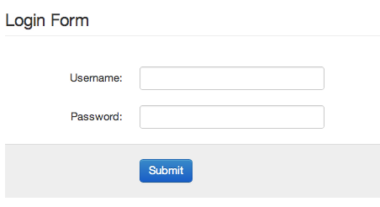


Exercises (4/4)
JSF
Authentication
Employee
Manager

Slide 72
DataModel
JSF
Or how populate DataTable

Slide 73
DataModel concept
DataModel
DataModel is an abstraction around arbitrary data binding technologies
Can be used to adapt a variety of data sources for use by some JavaServer Faces components
A DataTable for example
DataSource
Get Selected Object
DataModel
Values
SelectedRow (id row)
A | B
C | D
Web page

Slide 74
Class and implementations
DataModel
Abstract class
DataModel
Implementations
ArrayDataModel : for wrapping an array
ListDataModel : for wrapping a List
ResultDataModel : for wrapping JSTL Result
ResultSetDataModel : for wrapping ResultSet
ScalarDataModel : for wrapping individual Java object

Slide 75
Creation
DataModel
Declare a DataModel and instantiate it with an implementation
You can change (or initialize) the wrapped data thanks to:
DataModel model = new ListDataModel();
DataModel model2 = new ListDataModel(myList);
model.setWrappedData(myList);

Slide 76
Usage
DataModel
Use your DataModel in a <h:dataTable>
It works like a foreach loop
To get the selected Object in the dataTable
<h:dataTable value="#{bean.model}" var="p">
...
</h:dataTable>
MyObject o = (MyObject) model.getRowData();

Slide 77
Stop-and-think
DataModel
Do you have any questions ?
???

Slide 78
Exercises (1/3)
JSF
Our project will be an application to help manager measured time (in days) each employee has passed to work for a client
This data are useful for the billing !
Each manager can manage several employees
So we’re going to start the application development by the following User Stories:
As a Manager, I want to be able to add employees
As a Manager, I want to be able to list all employees I manage (The ones I created)

Slide 79
Exercises (2/3)
JSF
Create a new Facelets page : add_employee.xhtml
It must contain a form ta add a new employee and associate him to the current manager
Create :
A Managed Bean EmployeeController
An EJB class EmployeeService
Complete them and make the form work
Use a DataModel with a DataTable and list on the manager home page all its employees

Slide 80
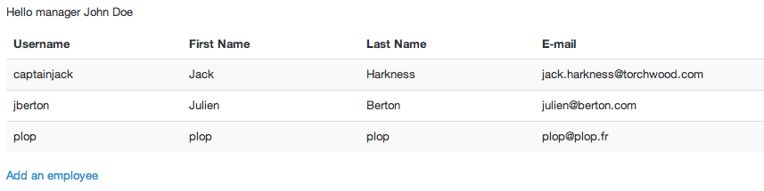
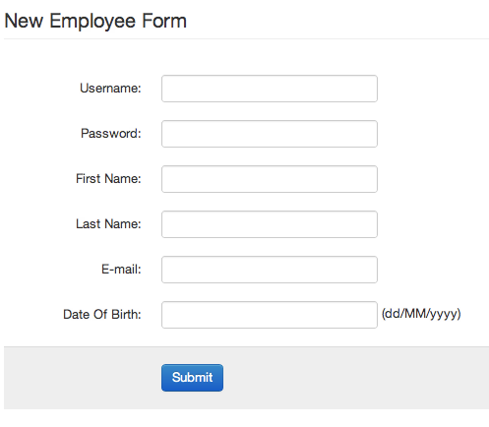
Exercises (3/3)
JSF

Slide 81
JSF Lifecycle
JSF

Slide 82
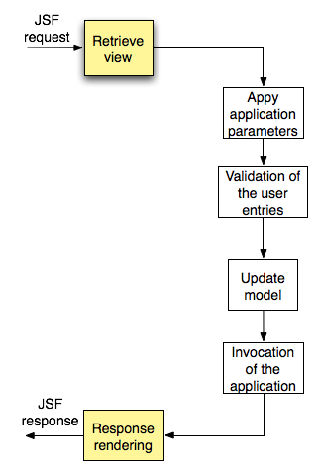
Lifecycle
JSF Lifecycle
Retrieve view :
Build the tree components of the page

Slide 83
Lifecycle
JSF Lifecycle
Apply application parameters :
Retrieve all the values in the request parameter

Slide 84
Lifecycle
JSF Lifecycle
Validation of the user entries :
Validate all the user entries.
If the validation succeed the lifecycle continue. Otherwise an exception is thrown.

Slide 85
Lifecycle
JSF Lifecycle
Update model :
Update all the models if the validation and the conversion succeed.
Convert thanks to converter the String parameter to Object values. If conversion fail an exception is thrown.

Slide 86
Lifecycle
JSF Lifecycle
Invocation of the application :
Invoke the requested method of the managed bean. Can eventually choose the next page.

Slide 87
Lifecycle
JSF Lifecycle
Response rendering :
Create the page rendering.

Slide 88
Stop-and-think
JSF Lifecycle
Do you have any questions ?
???

Slide 89
Converter
JSF

Slide 90

Context
Converter
Problem:
How to display Java objects in an text field ?
How to display … ?
Solution
Use a converter
Existing ones
Create Your own

Slide 91
Definition
Converter
A Converter
Converts an object into a String, or a String into an object
Concerns components which implement ValueHolder like
h:inputText, h:inputTextarea, h:selectManyMenu, …
JSF provides some converters:
<f:convertDateTime> for Date values
<f:convertNumber> for numbers
You have to create your own for all other objects

Slide 92
Provided converters
Converter
Converters provided by JSF
<f:converterDateTime>
dateStyle attribute: default, short, medium, long and full
<f:converterNumber>
Available attributes : maxFractionDigits, integerOnly, currencySymbol,…
<h:inputText value="#{bean.date}">
<f:convertDateTime dateStyle="full" />
</h:inputText >
<h:outputText value="#{conv.number}">
<f:convertNumber type="currency" />
</h:outputText>

Slide 93
Custom converters
Converter
Write your own converters
By implementing the javax.faces.convert.Converter interface
By declaring them inside the faces-config.xml file
public Object getAsObject(FacesContext context, UIComponent component, String value);
public String getAsString(FacesContext context, UIComponent component, Object value);
<converter>
<description>MyOwnConverter</description>
<converter-id>myOwnConv</converter-id>
<converter-class>
com.supinfo.sun.converters.MyOwnConverter
</converter-class>
</converter>

Slide 94
Custom converters
Converter
Write your own converters
Declare them inside the faces-config.xml file
Or put the @FacesConverter annotation on them
<converter>
<description>MyOwnConverter</description>
<converter-id>myOwnConv</converter-id>
<converter-class>
com.supinfo.sun.converters.MyOwnConverter
</converter-class>
</converter>
@FacesConverter
public class MyConverter implements Converter {
...
}

Slide 95
How to use them ?
Converter
First solution :
Second solution :
<h:outputText value="#{bean.person}"
converter="myOwnConv" />
<h:outputText value="#{bean.person}">
<f:converter converterId="myOwnConv" />
</h:outputText>

Slide 96

Life cycle
Converter
Conversion is processed inside « Apply application parameters » to retrieve values as objects …
… and during « Response Rendering » because we need to convert objects to values to insert them into web pages.

Slide 97
Tips and tricks
Converter
Converters are not directly managed by the container
So you can’t inject an EJB or another JEE component in it with annotations
If you really need to retrieve an EJB, you can:
Retrieve it with Context.lookup(…) method
Declare your converter as a ManagedBean
If you choose the last solution, you have to use an EL to use your converter into your views

Slide 98
Stop-and-think
Converter
Do you have any questions ?
???

Slide 99
Exercises (1/4)
JSF
Now, the next User Stories:
As a manager, I want to be able to add new clients
As an employee, I want to be able to declare a period of work associated with a client
As an employee, I want to be able to list all my declared periods of work

Slide 100
Exercises (2/4)
JSF
Create a new page add_client.xhtml
It must contain a simple form to add a client
Create an entity Client with the following properties :
An id as Long
A name as String
Create a new Managed Bean and a new Service for Client
Complete them and make the form work

Slide 101
Exercises (3/4)
JSF
Create a new page add_worktime.xhtml
It must contain a simple form to associate a period of work with a client
Create an entity WorkTime with the following properties :
An id as Long
A beginDate as Date persisted as a simple date (not time)
An endDate as Date persisted as a simple date (not time)
A client as Client
Create and complete a new Managed Bean and a new Service classes
Notes:
You’ll need to use SelectItem objects and create a converter for the select box.
Don’t forget to override equals method for Client class… Why ? Because SelectOneMenu component check with the equal method that the selected item is valid with this method.

Slide 102
Exercises (4/4)
JSF
Update the employee home page
Use a DataModel with a DataTable and list all work times
On each line of the data table, provide a Remove link to remove a work time

Slide 103
Validation
JSF

Slide 104


Definition
Validation
In a form
You can set constraints to fields
Concern components which implement EditableValueHolder like …
h:inputText, h:inputTextarea, h:selectManyMenu, …

Slide 105
Apply constraints
Validation
By using the required attribute
By using common validators: <f:validateDoubleRange>, <f:validateLength>, <f:validateLongRange>
<h:inputText required="true" />
<h:form>
<h:inputText id="name">
<h:outputLabel for="name" value="Name:"/>
<f:validateLength minimum="3" maximum="10"/>
</h:inputText>
<%--display a validation message%-->
<h:message for="name" />
</h:form>

Slide 106
Create your own validations
Validation
By creating a method inside a ManagedBean …
… and call it in your web page
public void validate(javax.faces.context.FacesContext context, javax.faces.component.UIComponent component,
Object value ){
//validation process
}
<h:inputText validator="#{bean.validate}" />

Slide 107
Create your own validations
Validation
By creating a class which implements the Validator interface (javax.faces.validator.Validator)
Declare it
Use it
public class MyValidator implements Validator {
public void validate(FacesContex tcontext, UIComponent component, Object value);
//throw ValidatorException containing FacesMessages if error
}
<validator>
<validator-id>emailValidator</validator-id>
<validator-class>MyValidator</validator-class>
</validator>
<h:inputText>
<f:validator validatorId="emailValidator" />
</h:inputText>

Slide 108
Create your own validations
Validation
By creating a class which implements the Validator interface (javax.faces.validator.Validator)
Declare it by annotation (@FacesValidator) or by XML :
Use it
public class MyValidator implements Validator {
public void validate(FacesContex tcontext, UIComponent component, Object value);
//throw ValidatorException containing FacesMessages if error
}
<validator>
<validator-id>emailValidator</validator-id>
<validator-class>MyValidator</validator-class>
</validator>
<h:inputText>
<f:validator validatorId="emailValidator" />
</h:inputText>

Slide 109

Message handling
Validation
Message are useful to display validation information
Insert FacesMessages messages into FacesContext
public void check(ActionEvent ae) {
//RetrieveFacesContext
FacesContext context = FacesContext.getCurrentInstance();
//CreateFacesMessage
FacesMessage message =
new FacesMessage( FacesMessage.SECURITY_WARN,
"Summary", "Detail of the message" );
//Add message to the context
//null is replaced by a components id (String)
context.addMessage(null, message);
}

Slide 110
Message handling
Validation
To display the message you have two markups
<h:messages> : display all the message
<h:message> : display message associated with an id
You have some attributes on this markup
showDetail : true / false
showSummary : true / false
tooltip : true / false
…

Slide 111

Bean Validation
Validation
You can also use Bean Validation with JSF
We’ll see it later…

Slide 112
Stop-and-think
Validation
Do you have any questions ?
???

Slide 113
Templating
JSF

Slide 114
Why use templates ?
Templating
A template is used to display several pages
Your whole application is displayed in the same way
Change once and for all
Change your header
Change your footer
…

Slide 115
How does it work ?
Templating
In the template file
Use <ui:insert name="…"></ui:insert> to define "editable" areas
In another page
Use <ui:composition template="…"> to use the template
Inside this block use <ui:define name="…”> to "edit" areas

Slide 116
Example
Templating
Our template : Template1.xhtml
<html xmlns="http://www.w3.org/1999/xhtml"
xmlns:ui="http://java.sun.com/jsf/facelets"
xmlns:h="http://java.sun.com/jsf/html">
<head>
<title>
<ui:insert name="titre" />
</title>
</head>
<body>
<ui:insert name="content" />
#{param1}
</body>
</html>

Slide 117
Example
Templating
Use the previous template
<ui:composition
xmlns:ui="http://java.sun.com/jsf/facelets"
xmlns:h="http://java.sun.com/jsf/html"
template=“template1.xhtml">
<!-- Params-->
<ui:param name="param1" value="My value" />
<!-- Blocks -->
<ui:define name="titre">SunParadise</ui:define>
<ui:define name="content">
<p>
<h:outputText value="List places" />
</p>
</ui:define>
</ui:composition>

Slide 118
Stop-and-think
Templating
Do you have any questions ?
???

Slide 119
Composite Components
JSF
Create your own components

Slide 120
What is a composite component ?
Composite Components
A special type of template that acts as a component
A collection of markup tags and other existing components
Any XHTML page that contains markup tags and other components can be converted into a composite component !

Slide 121
Why create composite ?
Composite Components
You want to display the same things in a lot of pages
For example, details about a car
If you add a property inside your Car
You have to find all pages where it's displayed
And update them
It is long, it is bad …
Solution
Create a composite and display your Car with it
If You want to change the display, change only once ☺

Slide 122
How create a component ?
Composite Components
You don't have to write any Java code !
Create a XHTML page using <ui:composition> for defining your component
Create a descriptor for your component
A xxx.taglib.xml file
Declare your component in the web.xml file
Put those files in the WEB-INF folder

Slide 123
How create a component ?
Composite Components
The components XHTML page
car is the value of the car attribute passed to the component … keep focused …
<?xml version='1.0' encoding='UTF-8' ?>
<!DOCTYPE composition PUBLIC "-//W3C//DTD XHTML 1.0
Transitional//EN" http://www.w3.org/TR/xhtml1/DTDxhtml1-transitional.dtd>
<ui:composition
xmlns:ui="http://java.sun.com/jsf/facelets"
xmlns:h="http://java.sun.com/jsf/html">
<h:outputText value="#{car.brand}" />
</ui:composition>

Slide 124
How create a component ?
Composite Components
The component descriptor : supinfo.taglib.xml
<?xml version="1.0"?>
<!DOCTYPE facelet-taglib PUBLIC
"-//Sun Microsystems, Inc.//DTD FaceletTaglib 1.0//EN" "facelet-taglib_1_0.dtd">
<facelet-taglib>
<namespace>http://supinfo.com/sunparadise</namespace>
<tag>
<tag-name>myComp</tag-name>
<source>myComp.xhtml</source>
</tag>
</facelet-taglib>

Slide 125
How create a component ?
Composite Components
Declare it in the web.xml file
And use it
<context-param>
<param-name>facelets.LIBRARIES</param-name>
<param-value>/WEB-INF/supinfo.taglib.xml</param-value>
</context-param>
<?xml version='1.0' encoding='UTF-8' ?>
<!DOCTYPE html PUBLIC "-//W3C//DTD XHTML 1.0 Transitional//EN" "http://www.w3.org/TR/xhtml1/DTD/xhtml1-transitional.dtd">
<html xmlns="http://www.w3.org/1999/xhtml"
xmlns:ui="http://java.sun.com/jsf/facelets"
xmlns:f="http://java.sun.com/jsf/core"
xmlns:h="http://java.sun.com/jsf/html"
xmlns:supinfo="http://supinfo.com/sunparadise">
<supinfo:myComp car="#{myCar}" />
</html>
Notes:
Explain that the supinfo taglib is declared and that the car attribute will be used in the component page…

Slide 126
Stop-and-think
Composite Components
Do you have any questions ?
???

Slide 127
Advanced concepts
JSF
For an advanced use of JSF

Slide 128
FacesContext
Advanced concepts
FacesContext allow to get all the information associated to the client request and response
It contains the
ExternalContext : get the information in the client request and response
ApplicationContext: get the context of the web application
ViewRoot : get the root component instance of the JSF view
And a lot of other stuffs…

Slide 129
FacesContext
Advanced concepts
Get a request parameter
Get a ManagedBean instance
public void stuff() {
FacesContext context = FacesContext.getCurrentInstance();
ExternalContext external = context.getExternalContext();
Map<String, String> params = external.getRequestParameterMap();
System.out.println(params.get("id"));
}
public void stuff() {
FacesContext context = FacesContext.getCurrentInstance();
Application app = context.getApplication();
MyBean o = (MyBean) app.evaluateExpressionGet(context,
"#{myBean}", MyBean.class);
}

Slide 130
FacesContext
Advanced concepts
You can see several other usage examples of the FacesContext here:
https://github.com/bargenson/TicketManager/blob/master/src/main/java/fr/bargenson/util/faces/ControllerHelper.java

Slide 131

Internationalization (I18N)
Advanced concepts
It allows you to provide localized applications
This feature is based over property files
lang_en.properties
lang_fr.properties
lang.properties
All of them should contain the same keys
my_message=My favorite web site
my_message=Mon site préféré
my_message=Meine Webseite
Notes:
If we try to display a message that does not appears in a properties file, JSF will look in the defaut properties file and if it is not found, an error is displayed.

Slide 132
Internationalization (I18N)
Advanced concepts
How to handle these values ?
From web pages, call the <f:loadBundle> tag
You can also use EL to retrieve entries
A different value appear according to the selected language
<f:loadBundle basename="com.supinfo.sun.resources.lang"
var="msg"/>
<f:view>
<h:outputText value="#{msg.message}"/>
</f:view>

Slide 133
Security
Advanced concepts
Problem
How to restrict page access in JSF ?
If the user is currently logged in and he come again on my website, how can I redirect him to his welcome page ?
…
Solution
Use one of solutions provide by Servlet API
Use JAAS (too long to see it during this course)
Use a Servlet Filter !
Notes:
You can see an example of application using JAAS here: https://github.com/bargenson/TicketManager

Slide 134
Reminder: Servlet Filter
Advanced concepts
Create a class implementing the javax.servlet.Filter interface
Define the methods
init(FilterConfig)
doFilter(ServletResquest, ServletResponse, FilterChain)
destroy()

Slide 135
Reminder: Servlet Filter
Advanced concepts
In the doFilter method
To continue the evaluation of other Filter use the doFilter(ServletRequest, ServletResponse) of the FilterChain
To redirect a user, call the method sendRedirect(String newPage) on a HttpServletResponse

Slide 136
Reminder: Servlet Filter
Advanced concepts
Declare Your filter in the web.xml file
Or use the @WebFilter annotation
<filter>
<filter-name>MyFilter</filter-name>
<filter-class>
com.supinfo.sun.filters.MyOwnFilter
</filter-class>
</filter>
<filter-mapping>
<filter-name>MyFilter</filter-name>
<url-pattern>*.jsp</url-pattern>
</filter-mapping>

Slide 137
Module Quiz introduction
Advanced concepts
What is the meaning of « _en » in the following filename « lang_en.properties »
It means it is a file contains the english text translation
How manage security with JSF ?
Use Java Authentication and Authorization Service or a Servlet Filter
Can we inject an EJB with @EJB inside a managed bean ?
Yes

Slide 138
Stop-and-think
Advanced concepts
Do you have any questions ?
???

Slide 139
Exercises (1/2)
JSF
Now, you know how to use validators and i18n in JSF
Refactor your code and
Validate all your forms
All fields are required
Email must be well formatted
Birthdates must be in the past
Use i18n
Create a Filter class to allow
Only authenticated managers to access managers pages
Only authenticated employees to access employees pages

Slide 140
Exercises (2/2)
JSF
Create three template files
manager.xhtml, a template use for managers pages
employee.xhtml, a template use for employees pages
authenticated.xhtml, a template use by the two previous template

Slide 141

Summary
JSF
JSF make you think your web site as a real application
JSF increase your productivity
JSF is well adapted with medium and large projects

Slide 142


